Slide 1
Deep Learning streamer
Notes:
Next, we are going to take a look at the DL Streamer, which becomes part of the default installation from the OpenVINO toolkit 2020R2 release, enables developers to create and deploy optimized streaming media analytics pipelines across Intel® architectures.

Slide 2


Introducing.. Dl streamer
Intel® Distribution of OpenVINO™ toolkit Deep Learning (DL) Streamer, now part of the default installation package
Enables developers to create and deploy optimized streaming media analytics pipelines across Intel® architecture from edge to cloud
Optimal pipeline interoperability with a familiar developer experience built using the GStreamer multimedia framework
+
Notes:
DL Streamer is a streaming analytics framework based on the GStreamer library. Its interoperable with other GStreamer plugins will allow developers to leverage existing GStreamer media processing elements, such as decode, video post-processing, encode, and build an end-to-end pipeline.

Slide 3
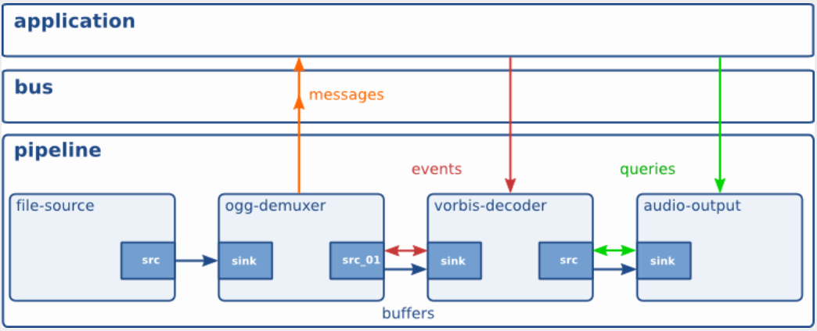
What is GStreamer?
A pipeline consists of connected processing elements
Each element is provided by a plug-in and can be grouped into bins
Elements communicate by means of pads – source pad and sink pad
Data buffers flow from Source element to Sink element & from source pad to sink pad
Ref: https://gstreamer.freedesktop.org/data/doc/gstreamer/head/manual/manual.pdf
Notes:
In case you are not quite familiar with GStreamer, here’s a very brief introduction to it. It is used for building pipelines with connected processing elements, and each element is provided by plugin-in and can be grouped into bins. Elements communicate through pads, the source pad and sink pad, data buffers flow from the source element to sink element and from source pad to sink pad.

Slide 4
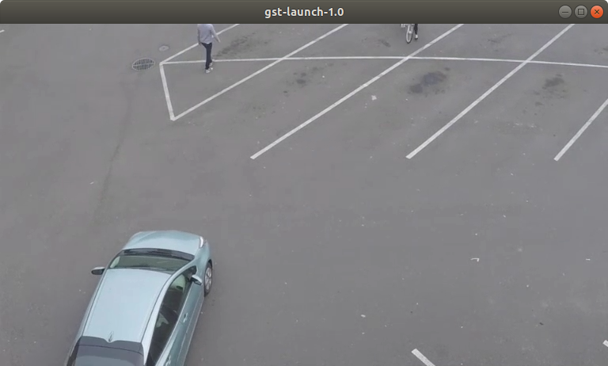
Media processing pipeline
Video Pipeline – decode, convert, render
filesrc
decodebin
videoconvert
xvimagesink
input HW/SW convert render decode on screen
gst-launch-1.0 filesrc location=/path/to/video.mp4 ! decodebin ! videoconvert ! xvimagesink
Notes:
This is an example of using purely GStreamer elements to create a media processing pipeline, it will read a video file, then decode it, convert it, and render it. In the command line, the GStreamer launcher, gst-launch-1.0 accepts a textual description of a pipeline, instantiates it, and sets it to the PLAYING state. It allows you to quickly check if a given pipeline works, before going through the actual implementation using GStreamer API calls.

Slide 5
Media analytics pipeline
Storage
Display
DL Streamer
Decode
Scale/ CSC
Inference
Tracking
Inference
Publish/ Process / Overlay
Crop scale
720p
1080p
4K
(AVC, HEVC)
Resize to 224x224 RGB
Object Detection
Object Tracking
Object Classification
Application logic to consume inference results
Notes:
To create the media analytics pipeline, we will use the elements provided by the DL Streamer to work with the basic GStreamer elements. From the page, you can see the purple blocks are the DL Streamer elements which utilize the OpenVINO toolkit inference engine at the backend, grey blocks are the GStreamer elements.
So, the workflow here is, GStreamer elements read the video from cameras, decodes the video and scales it to the right size the first model requires, then the DL Streamer elements handles the inferencing tasks as we showed in the Multi-model session. Several models here are chained together, also DL Streamer handles the post-processing of the models' outputs, like generating the overlays, for the GStreamer elements to finally display or store.

Slide 6
Media analytics pipeline
Storage
Display
DL Streamer
Decode
Scale/ CSC
Inference
Tracking
Inference
Publish/ Process / Overlay
Crop scale
CPU
GPU Media FF
CPU
GPU Media FF
CPU
GPU
VPU
CPU
CPU
GPU
VPU
CPU
Notes:
The decode and scale elements of GStreamer are supported on either CPU or GPU, while the elements of DL Streamers with the OpenVINO toolkit inference engine at the backend, support to run the inference workload on CPU, GPU, and VPU.

Slide 7
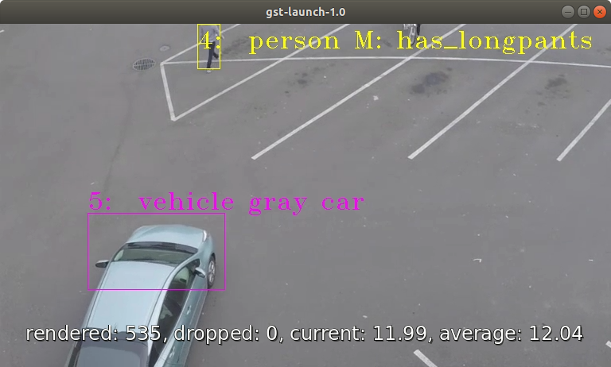
Using the dl streamer
Video Analytics pipeline – person and vehicle detection, person, vehicle attributes classification
filesrc
decodebin
gvadetect
gvatrack
gvaclassify
gvaclassify
gvawatermark
xvimagesink
Input
HW/SW
Decode
Person
Vehicle Detection
Object
Tracking
Person
Attributes
Recognition
Vehicle
Attributes
Recognition
Watermark
Render
On Screen
gst-launch-1.0 filesrc location=/path/to/video.mp4 !
decodebin ! videoconvert ! video/x-raw,format=BGRx ! \
gvadetect model=person-vehicle-bike-detection-crossroad-0078.xml model-proc=person-vehicle-bike-detection-crossroad-0078.json inference-interval=10 threshold=0.6 device=CPU ! queue ! \
gvatrack tracking-type="short-term" ! queue ! \
gvaclassify model= person-attributes-recognition-crossroad-0230.xml model-proc= person-attributes-recognition-crossroad-0230.json reclassify-interval=10 device=CPU object-class=person ! queue ! \
gvaclassify model= vehicle-attributes-recognition-barrier-0039.xml model-proc= vehicle-attributes-recognition-barrier-0039.json reclassify-interval=10 device=CPU object-class=vehicle ! queue ! \
gvawatermark ! videoconvert ! fpsdisplaysink video-sink=xvimagesink sync=true
Notes:
Here’s a Media Analytics Pipeline example, person and vehicle detection with person and vehicle attributes classification.
So we will use the object detection DL Streamer element “gvadetect” to handle the person and vehicle detection model, then use object tracking DL Streamer element “gvatrack” to track each object detected by “gvadetect”, after that, two classification elements “gvaclassify” are used for recognizing the attributes of each the detected person or vehicle, and one watermark DL Streamer element “gvawatermark” to generate the overlay to add to the original frame, such as the bounding boxes and attributes text. Each element has its properties need to be set correctly.
From the console log, we can see we need to provide the path to the IR models, the device type for running the inference, and the path to a JSON file with the description of input and output layers, labels, and method used to pre-process or post-process. And you can also set the inference-interval and reclassify-interval to run the inference less frequently.

Slide 8




Under the hood: dl streamer
Application
Reference Application Designs
GStreamer framework
GStreamer Media Plugins (Standard)
DL Streamer - GStreamer Video Analytics (GVA) Plugin
GStreamer plugins
Decode
VPP
Encode
Detect
Classify
Track
Publish
Runtime Libraries
Libav
OpenCV
MQTT/ Kafka
VAAPI
Intel® Distribution of OpenVINO™ toolkit Deep Learning
Inference Engine
Hardware
Want to know more: check out the webinar
https://software.seek.intel.com/openvino-webinar-series
Ready, Steady, Stream: Introducing Intel® Distribution of OpenVINO™ toolkit Deep Learning Streamer
Notes:
In summary, we have showcased the example building a Media Analytics Pipeline in the command-line, but you can also build it in your application by using GStreamer APIs, which provide the access to both generic GStreamer plugins and DL Streamer plugins. At the runtime library level, GStreamer uses VAAPI to utilize the encoder or decoder on GPU, while DL Streamer encapsulates the OpenVINO toolkit Inference Engine.

